Slide 1
Employee Data Analysis using Excel
STUDENT NAME: KEERTHANA.A
REGISTER NO: 312218053
NM ID(username): E191DD7D8052193BB1E44B18CF7C5A43
DEPARTMENT: BCOM (COMMERCE)
COLLEGE : ST ANNES ARTS AND SCIENCE COLLEGE

Slide 2
PROJECT TITLE
Employee Performance Analysis using Excel

Slide 3


AGENDA
Problem Statement
Project Overview
End Users
Our Solution and Proposition
Datasets Description
Modelling Approach
Results and Discussion
Conclusion
3/21/2024 Annual Review

Slide 4

PROBLEM STATEMENT
The purpose of employee performance analysis,due to the following reason
Identify strengths and weaknesses
Provide feedback
Employee
performance analysis
Maintain healthy relationships
Set goals
Assess recruitment practices
Succession planning

Slide 5

PROJECT OVERVIEW
Objective: To evaluate and understand employee performance in order to recognize achievements, identify areas for improvement, and implement strategies to enhance overall productivity and effectiveness.
The performance analysis highlights key strengths and areas for growth among employees. By implementing targeted development programs and refining performance management practices, organizations can drive overall improvement and recognize valuable contributions.

Slide 6
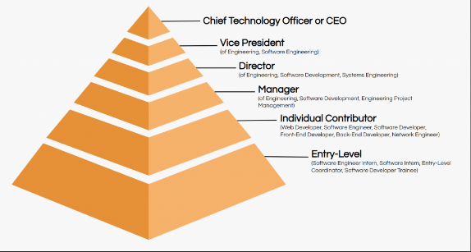

WHO ARE THE END USERS?

Slide 7

OUR SOLUTION AND ITS VALUE PROPOSITION
Conditional Formatting -
To find out the blank value
Filter -
To remove
3.Formula -
To Analyzing of Performance
4.Pivot table -
Summary of Data
5.Graph -
Visualization of Data

Slide 8
Datasets Description
employee id | number
employee name | text
employee type | text
employee performance level | text
gender | male/female
employee rating | number
employee Department | text
employee location | text

Slide 9

THE "WOW" IN OUR SOLUTION
Performance level
=IFS (Z8>=5,”VERY HIGH”,Z8>=,”HIGH”,Z8>=3,”MED”,TRUE,”LOW)”
>5 | VERY HIGH
>4 | HIGH
>3 | MED
BELOW 2 | LOW
3/21/2024 Annual Review

Slide 10
MODELLING
DATA COLLECTION
- EDUNET dashboard
2. FEATURE COLLECTION
3.DATA FILTE
-Conditional formattin
4. PIVOT TABLE
5 GRAPH

Slide 11
RESULTS

Slide 12
HIGH PERFORMANCE LEVEL

Slide 13
conclusion
In conclusion, the employment performance analysis reveals a comprehensive picture of employee contributions and areas for growth over the review period.
The graph shows that the PL shows the high performance among the entire department
The management can show up the upgradation of the developing ht employee performance through following
assigning new task
development
training
compensation

